Slide 1
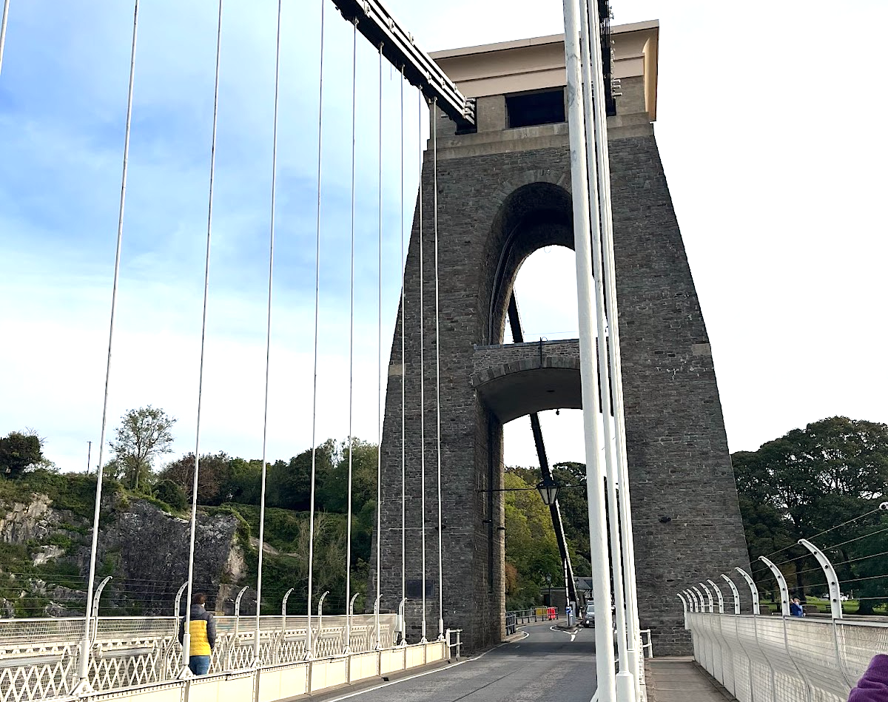
Clifton Suspension Bridge Visitor Centre
Cerys, Laura & Luke

Slide 2
Challenge Summary
The Clifton Bridge Visitor Centre is hidden away on the west wing of the bridge.
With its out of date interactions, it lacks entertainment and engagement for tourists. In turn, there is a deficiency in strong pull factors, leading to short term visits.
We want to increase the overall outcome of visitors' experiences by creating a fun interactive artifact that mitigates the current issues.
This can be accomplished with a variety of visual and/or audio methods.

Slide 3
Current Situation
Missing entertainment
Out of date interactions at visitor centre
Insufficient engagement with the younger generation (Ages 8-16)
Lack of directions and knowledge of Visitor Centre

Slide 4

What are we trying to achieve?
Increase tourism for the Visitor Centre
Educate the youth on the suspension bridge
Increase engagement with the younger generation in the form of entertainment

Slide 5
Audience
Impact
The interactive project will be designed for all ages with a focus on children aged 8-16.
The Clifton Suspension Bridge Visitor Centre
The youth will be educated and entertained by the exhibit
The Visitor Centre will gain more foot traffic potentially resulting in more funding

Slide 6
Constraints
Indoors
Outdoors
There are separate rooms in the Visitor Centre where there is a large amount of space to put this project, mainly upstairs
Tourists have to go into the Visitor Centre to begin with and then get them to travel upstairs
Accessibility issue with stairs?
High up so wind can catch
Dangerous being near traffic
No barrier
Hard to access without transport
Protected area on the bridge

Slide 7

Prototype
Unity
Maya
Physical Models
Video
Graphics
MAX msp

Slide 8
Prototype schedule
Week 1 – Introduction to Interaction Design
Week 2 – Embodied Interactions (Fieldwork Preparation)
Week 3 – Fieldwork
Week 4 – Creating Design Brief and The Problem Space
Week 5 – Design Brief Presentation
Week 6 Onwards - TBA

